Slide 1
ONLINE EXAM PORTAL
PROJECT BY –
Kasauti

Slide 2
Team – Kasauti
Jasman Arora(Scrum Master)
Aaron Rumao
Agam Jain
Badal Thosani
Chetan Pal
Prathama Morye
Sarvesh Kulkarni
Shubham Dave
Srikant Gurram
Sundaresan Elumalai

Slide 3
Agenda
Build the project according to the SRS.
Use agile methods for development
Follow software engineering guidelines
Learn and use tools such as HIBERNATE, Spring MVC and MAVEN.

Slide 4
Introduction
The Online Exam Portal system is an application used to appear for multiple choice questions online.
Students interested in appearing for the online exam can register on the application and appear for that respective exam.
The system allows the creation of new users in the system.
It gives access by two kinds of users :-
1) The system administrator
2) Normal users.

Slide 5
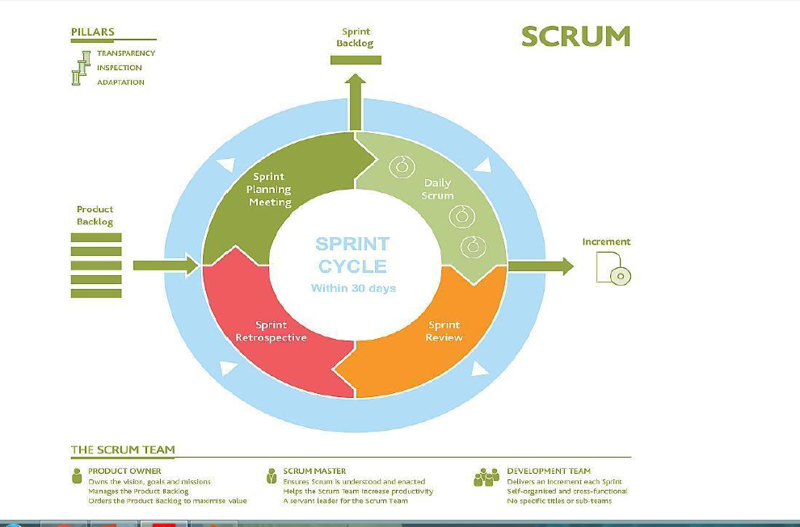
AGILE

Slide 6
What Did We Do ?
Captured requirements with the help of user stories
Planned sprints and conducted daily scrums
Designed the database schema based on phases
Designed the front end and UI for various roles and functionalities
Implemented the functionalities using Spring MVC and Hibernate
Integrated various modules to build a fully functional Online Exam Portal.

Slide 7
Functional Requirements
Admin Module:
To upload/delete course details.
To add question bank.
User Module:
To register/sign up into the system
Will be authenticated based on username/password.
Any user can be allowed to appear for any exam only once

Slide 8
Non-Functional Requirements
Browser compatibility
The application will be compatible with all browsers which support JavaScript and AngularJS.
Performance Requirements
The performance requirements for this application need to be benchmarked as per the SRS.
Time Bound
All Tests need to be time bound ( using session management)
Security
User passwords are hashed and the hash is stored in the database so that passwords are never directly obtainable from the database.

Slide 9
Project Team
Project Stake-Holders
Project Title | Online Exam Portal
Name of Client | AtoS
Project Sponsor | AtoS
Project Owners | AtoS
Scrum Master | Jasman
Architect | Agam
QA Manager | Prathama
Infrastructure Mgt. | Manipal Global Academy
Developers | Aaron Rumao, Agam Jain, Badal Thosani, Chetan Pal, Prathama Morye, Sarvesh Kulkarni, Shubham Dave, Srikant Gurram & Sundaresan Elumalai

Slide 10
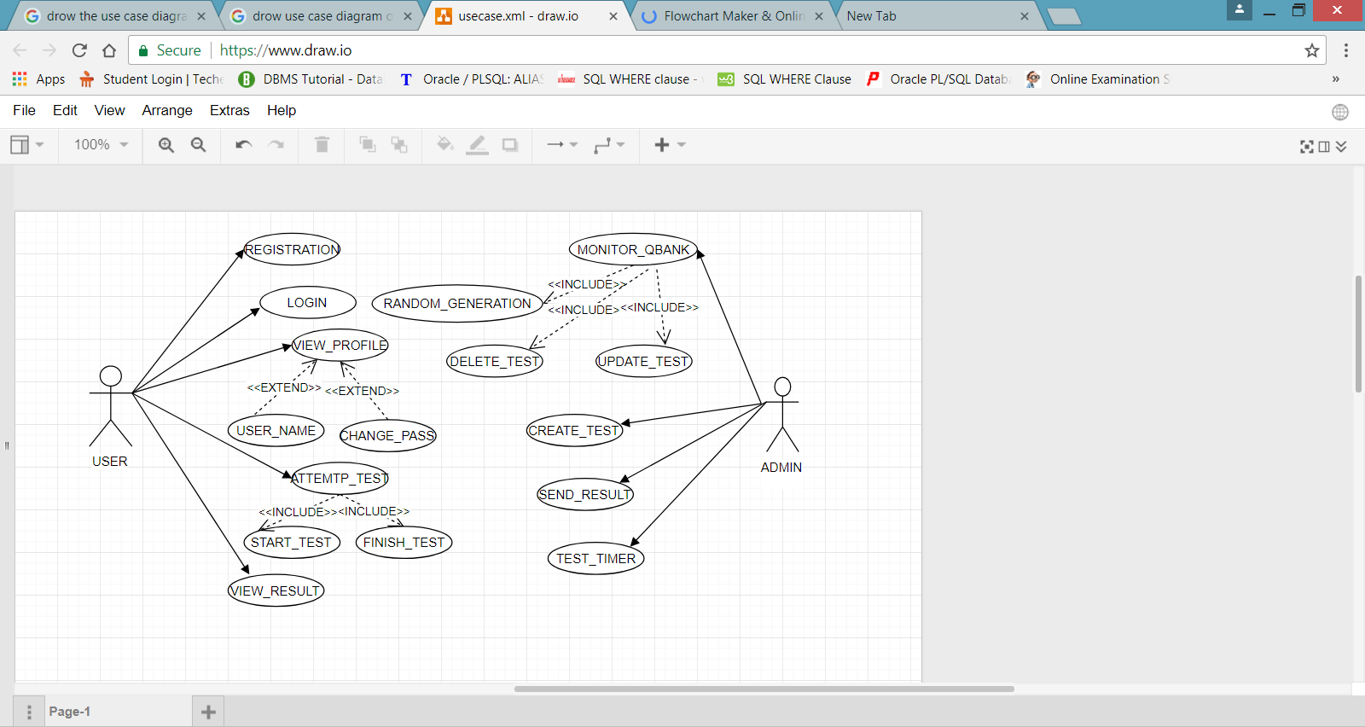
Use case diagram

Slide 11
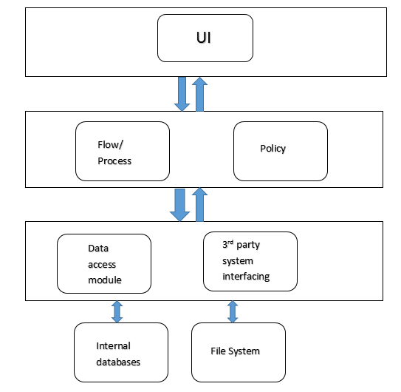
Application Architecture
Presentation Layer
Business logic layer
Data access layer

Slide 12
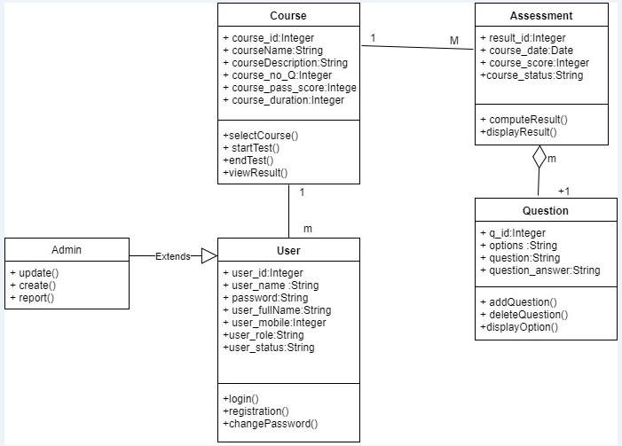
Class Diagram

Slide 13
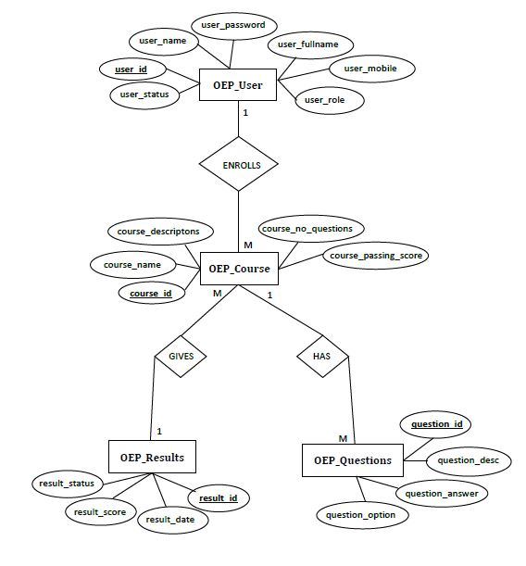
E-R Diagram

Slide 14


Slide 15
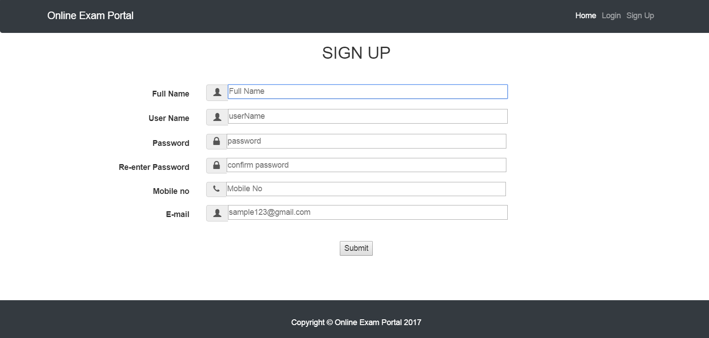

Slide 16
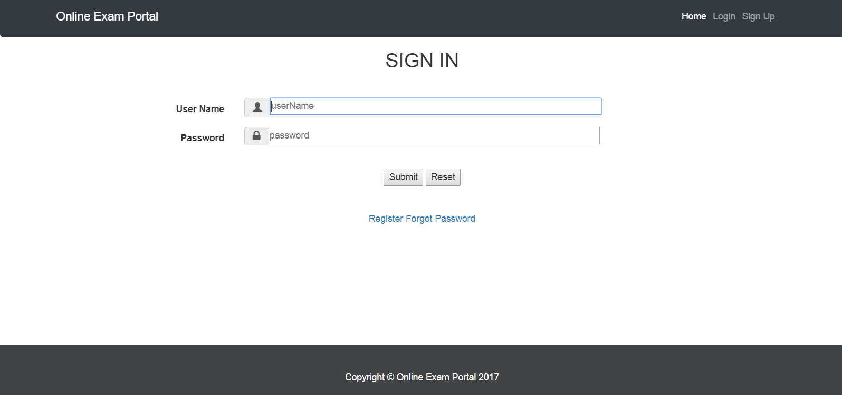

Slide 17


Slide 18
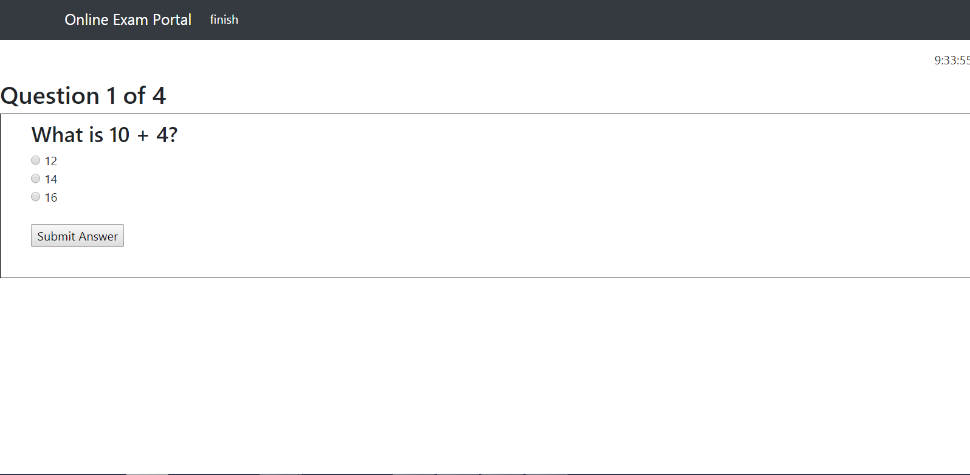

Slide 19
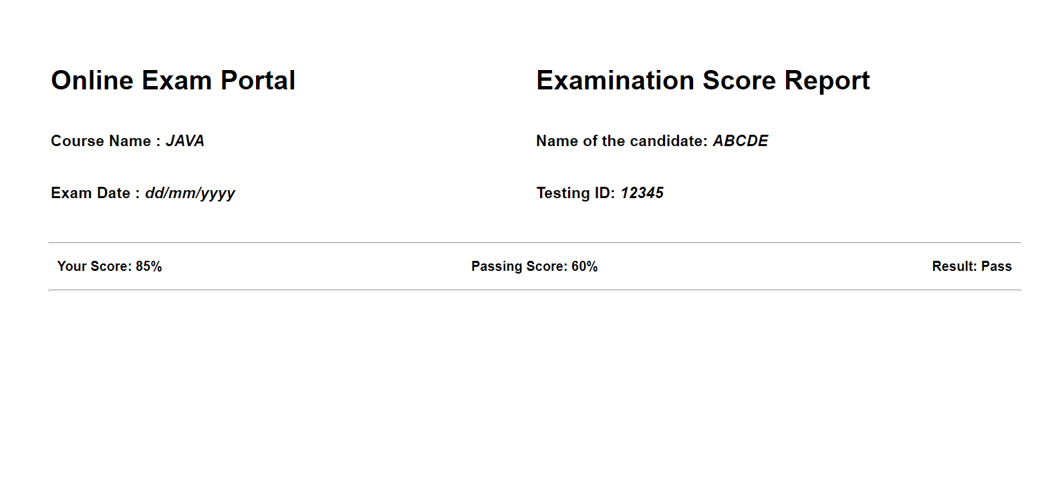

Slide 20
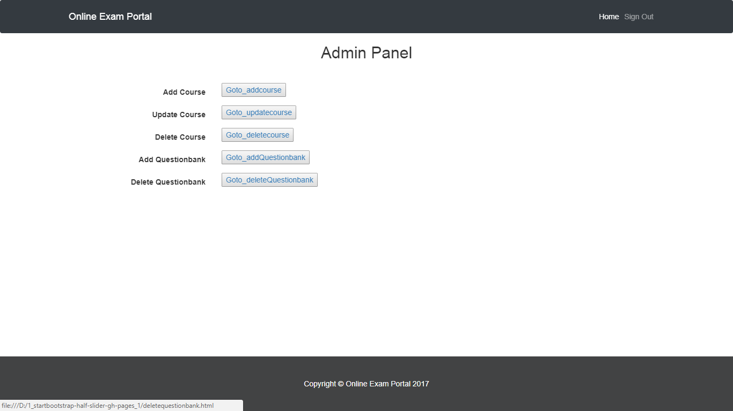

Slide 21
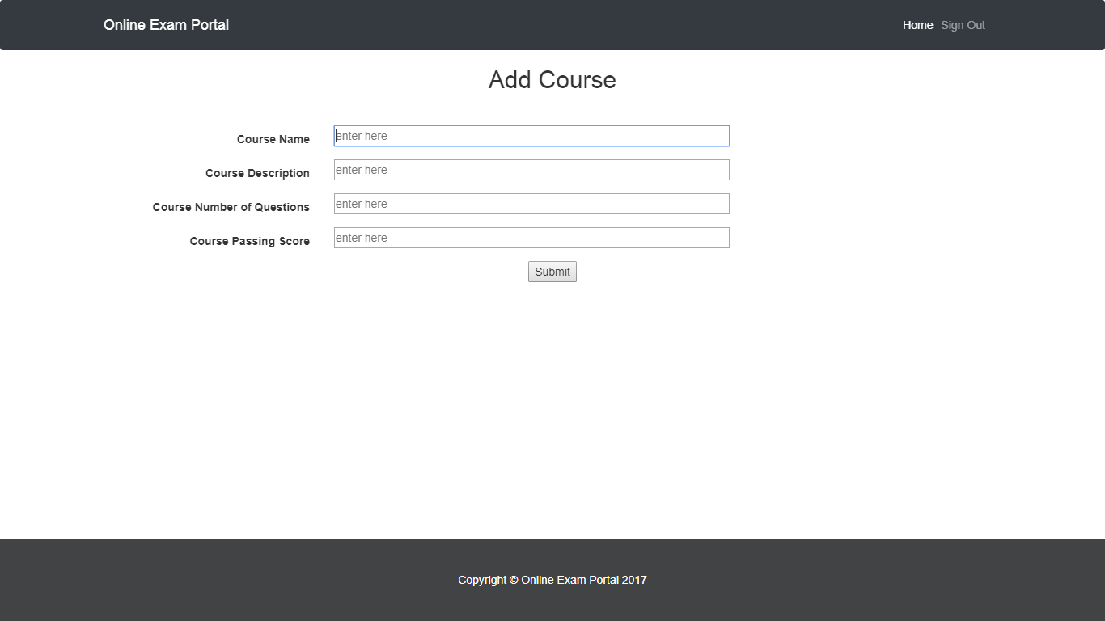

Slide 22
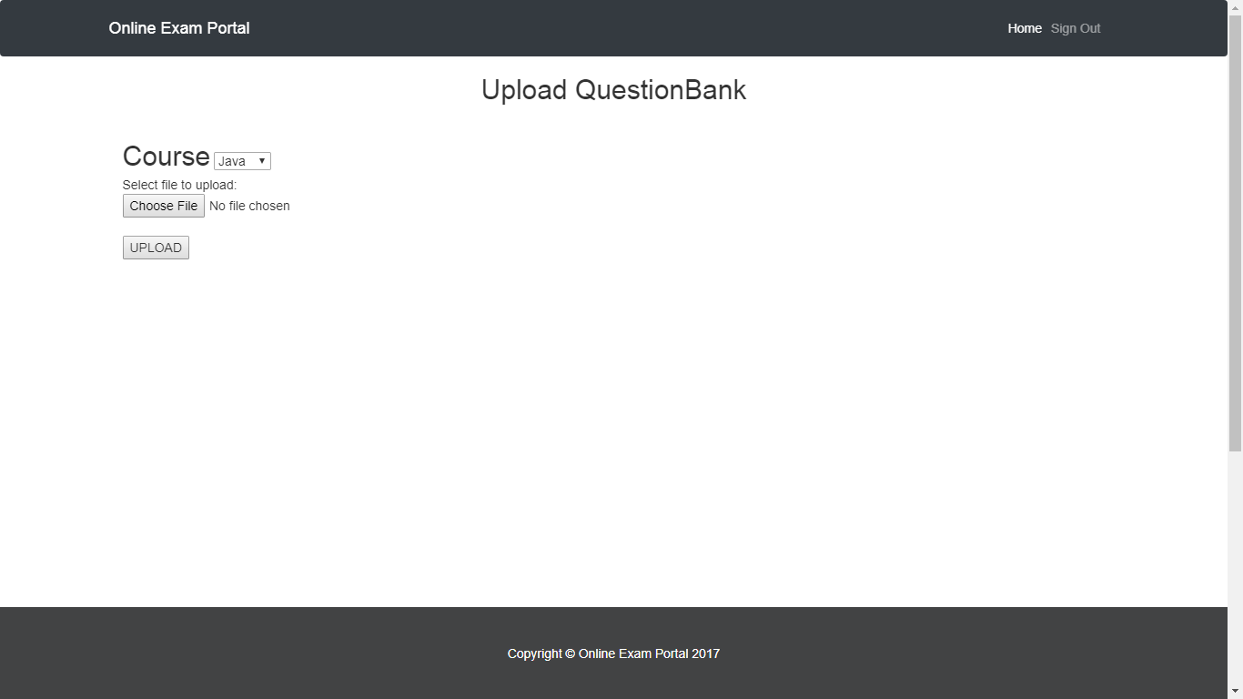

Slide 23
The Tech Stack
Server Side | Client Side
JSP | HTML 5, CSS
Hibernate | Bootstrap
Oracle database | JavaScript, AngularJS

Slide 24
IDE and other Tools
Tools | Software
Java IDE | Eclipse
Web Server | Apache Tomcat 8.0 Server
Database IDE | Oracle

Slide 25
Thank You…!!

